Slide 1




Halliburton Q&A Chatbot using RAG

Slide 2


Problem Statement
To develop a Q&A bot for the given dataset. Fine-tuning an open-source Language Model (LLM) or integrate a Retrieval-Augmented Generation (RAG) technique with an LLM.
DataSet
The Dataset contains 6 pdfs telling about the Company . Results of each Quarter from the year 2023 is mentioned in each PDF .

Slide 3
Hardware Requirements
CPU : A multi-core processor, like Intel Core i7
RAM : Minimum 8 GB RAM
Networking : Stable internet connection for model access
GPU : Optional but recommended for accelerated training and inference
System : Compatible with chosen OS (e.g., Windows, Linux) and required software libraries (e.g., PyTorch).

Slide 4
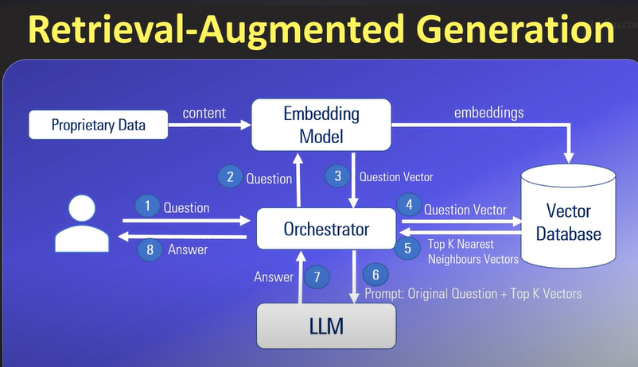
Tools Used
Embedding Model : all-MiniLM-L6-v2
Proprietary Data : 6 PDF sources of Halliburton
Vector Database : ChromaDB
Space consumed by data is less when compared to storing original unstructured data .So data is converted to vectors by embedding model[all-MiniLM-L6-v2] which is a default embedding model of chromaDB. Data in vector form is faster to extract .

Slide 5
4 . LLM : DistilBert
DistilBERT is a small, fast, cheap and light Transformer model trained by distilling BERT base. It has 66 million parameters, runs 60% faster than bert-base-uncased while preserving over 95% of BERT's performance . It is more efficient for smaller devices like mobile phones .
5. Orchestrator : LlamaIndex
Llama Index potentially outperforms Langchain with scalability, flexibility, rich features, user-friendliness, and community support. Its efficient handling of large text datasets, customizable functionalities, and supportive ecosystem make it a compelling choice for diverse text processing applications.

Slide 6
Solution
Data Chunking and Embedding : Utilize LlamaIndex to divide PDFs into 512-sized chunks with 100-sized overlapping, embedding them with a chosen model, and storing them in ChromaDB for efficient retrieval.
Model Loading: Load DistilBERT, a pre-trained transformer model, to process queries and contexts for question-answering tasks.
Query Processing: Submit queries to ChromaDB to retrieve relevant documents. The top 10 documents are selected based on relevance to the query.
Context Retrieval: Extract context from the retrieved documents and concatenate it with the query, preparing it for input to the model.

Slide 7
5. Model Inference: Pass the concatenated query and context, along with a prompt, to the DistilBERT model for inference, which predicts the answer to the query.
6. Integration and Automation: Integrate the entire pipeline into an automated system for seamless execution, enabling efficient and accurate retrieval of information from PDF documents.
Validation
Validation is conducted manually using user prompts by passing queries based on Halliburton dataset.

Slide 8
Thank you
Name : S.Mugunthan
Department : CSE
Email Id : mugunthan2783@gmail.com
College : Government college of Technology , Coimbatore

